Slide 1
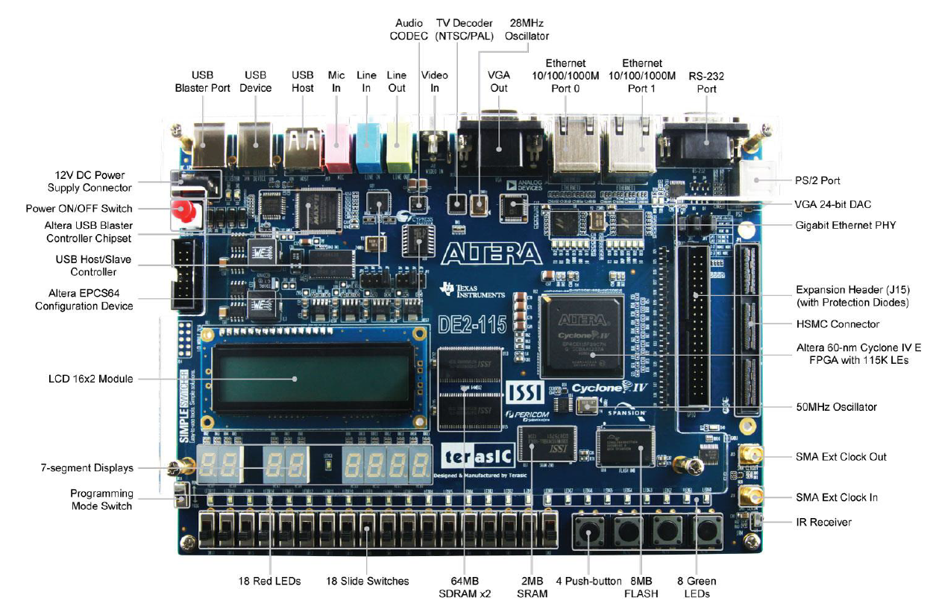
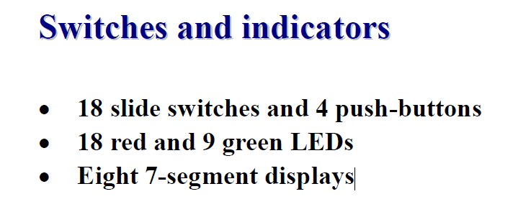
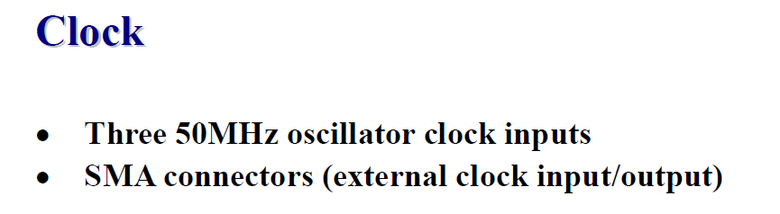
Available I/O

Slide 2
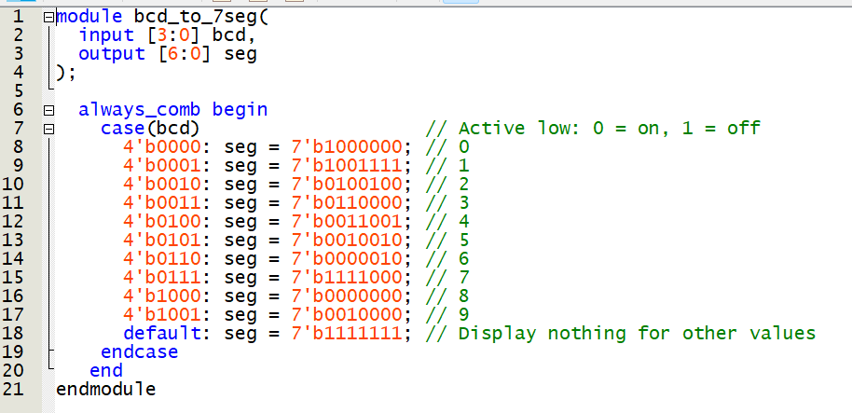
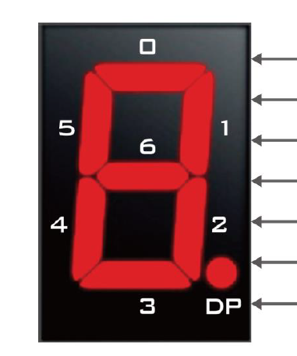
Num | L6 | L5 | L4 | L3 | L2 | L1 | L0
0 | 1 | 0 | 0 | 0 | 0 | 0 | 0
1 | 1 | 0 | 0 | 1 | 1 | 1 | 1
2 | 0 | 1 | 0 | 0 | 1 | 0 | 0
3 | 0 | 1 | 1 | 0 | 0 | 0 | 0
4 | 0 | 0 | 1 | 1 | 0 | 0 | 1
5 | 0 | 0 | 1 | 0 | 0 | 1 | 0
6 | 0 | 0 | 0 | 0 | 0 | 1 | 0
7 | 1 | 1 | 1 | 1 | 0 | 0 | 0
8 | 0 | 0 | 0 | 0 | 0 | 0 | 0
9 | 0 | 0 | 1 | 0 | 0 | 0 | 0
Def | 1 | 1 | 1 | 1 | 1 | 1 | 1

Slide 3
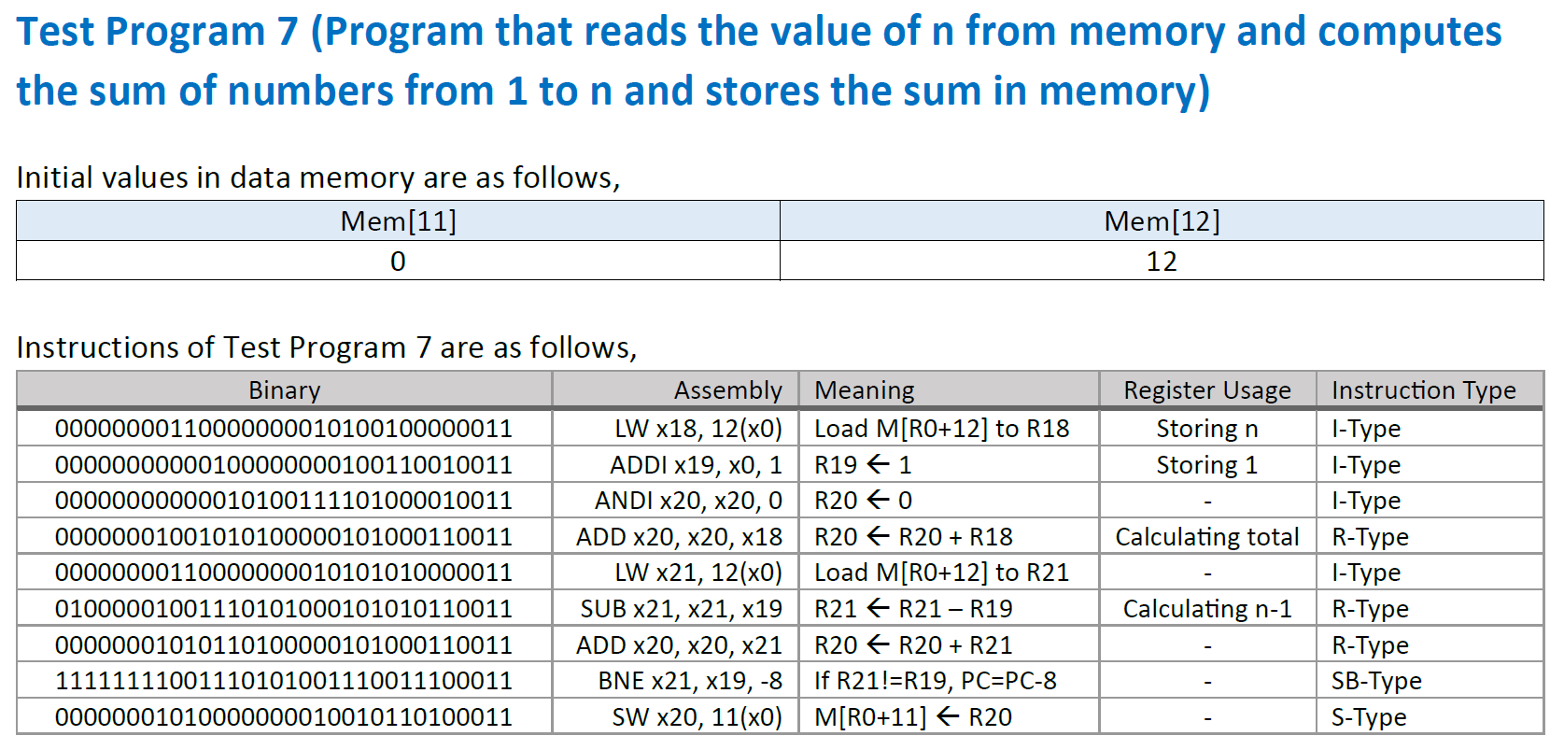
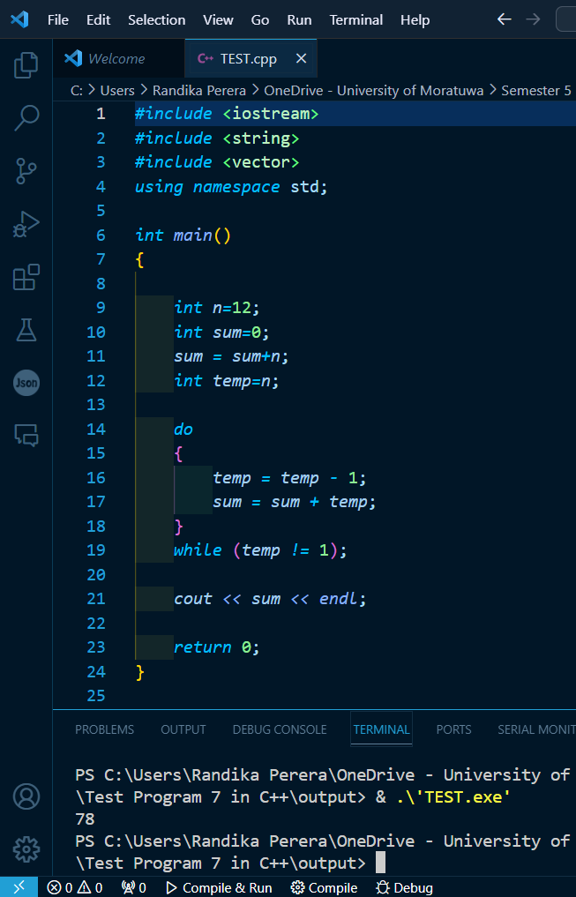
R18 = Mem[12] = 12
R19 = 1 #Represents 1
R20 = 0 #Represents sum
R20 = R20 + R18
R21 = Mem[12] = 12
R21 = R21 – R19
R20 = R20 + R21
If R21!=R19, PC=PC-8
.
.
.
Mem[11] = R20

Slide 4
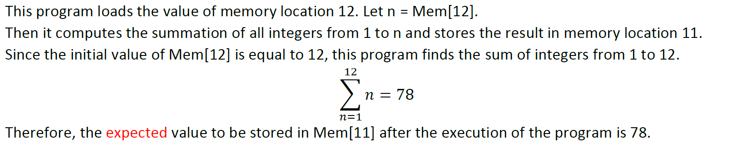
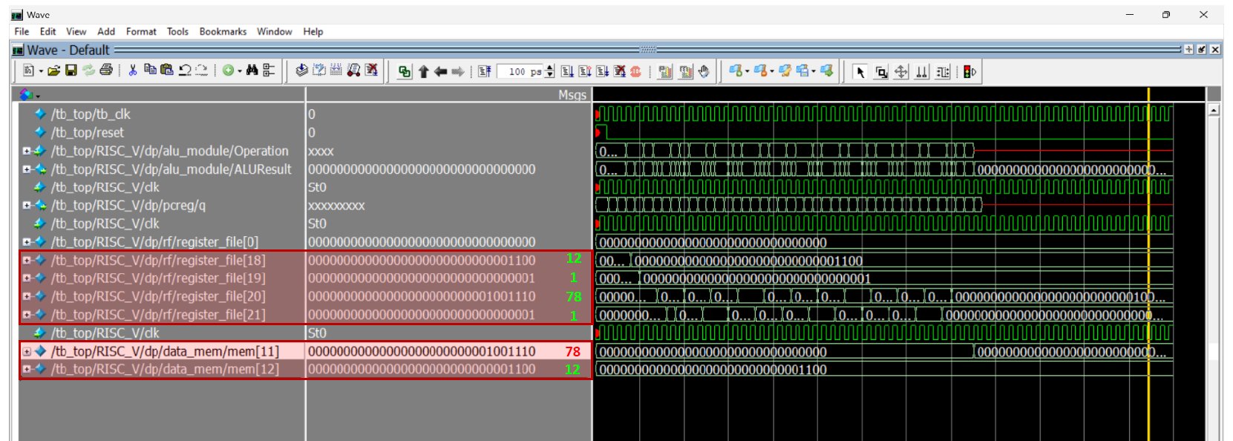

Slide 5
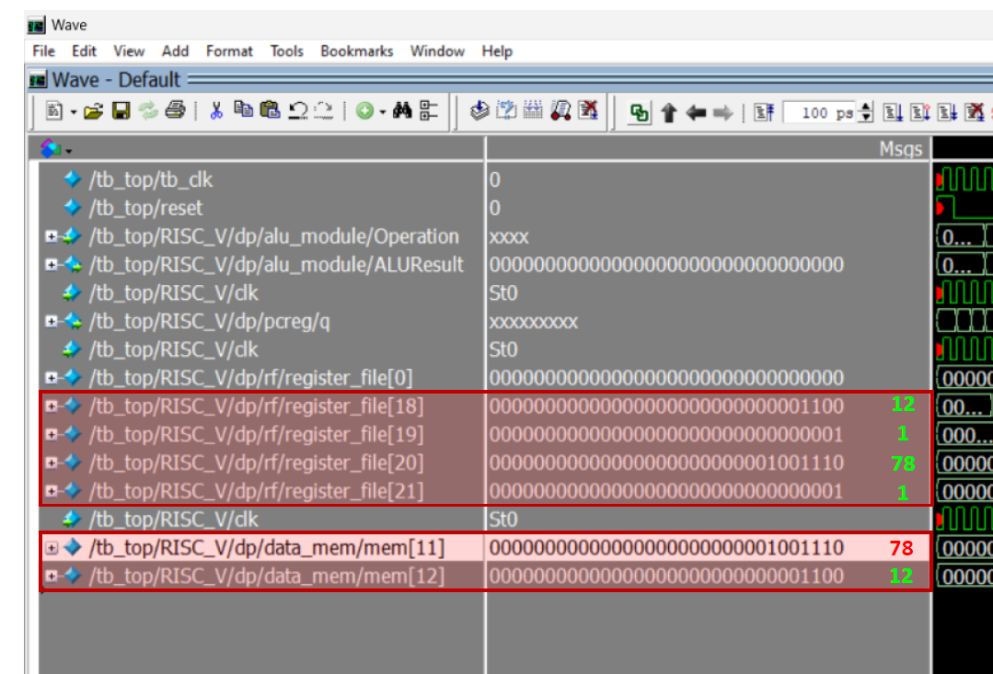
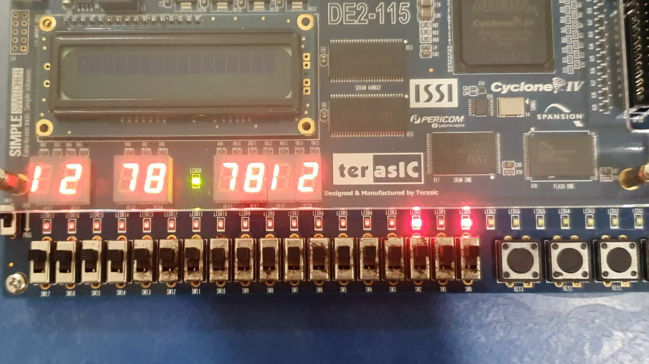
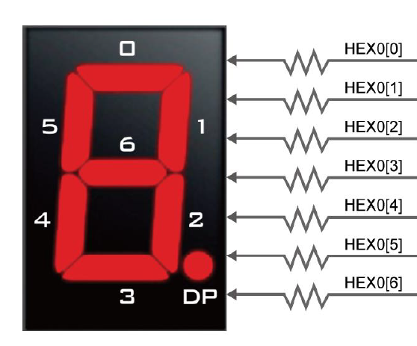
RESET
CLK
RF18
RF20
DM11
DM12
Reset = SW17
RF19 = LEDR2
RF21 = LEDR0
CLOCK = LEDG8
RF19
RF21
RF18 = HEX7 (Tens), HEX6 (Units)
RF20 = HEX5 (Tens), HEX4 (Units)
DM11 = HEX3 (Tens), HEX2 (Units)
DM12 = HEX1 (Tens), HEX0 (Units)
Used Clock divider to slow down 50MHz clock to 10Hz

